Slide 1
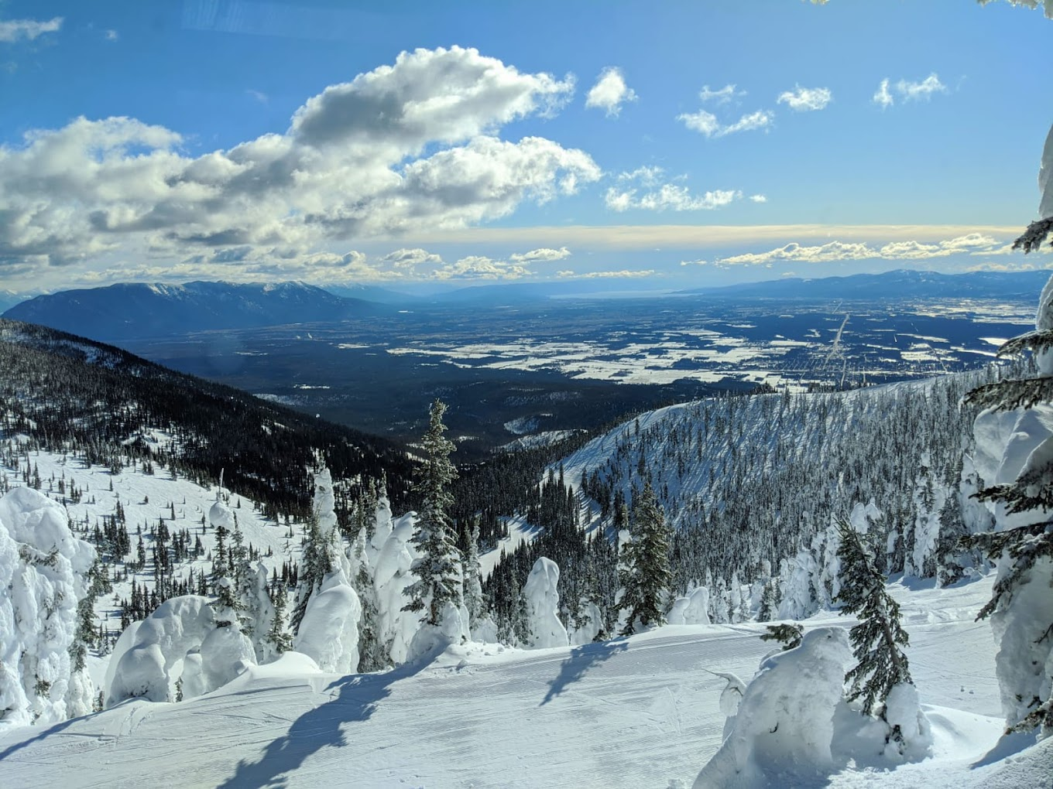
Big Mountain Resort
By
Tzega Abera

Slide 2
Introduction and Problem Statement
Big Mountain ski Resort in Montana offers spectacular views of Glacier National Park and Flathead National Forest, and its facility provides access to 105 trails entertaining 350,000 skiers and riders every year. Recently, the Resort has installed an additional chair lift to help increase the distribution of visitors. This, however, increases the operating costs by $1,5M this season. The resort needs to find out how to offset this cost, maximize capitalization in its market segment and project the revenue for the upcoming season.
How can Big Mountain Resort reduce its operational cost of $1,5M caused by a new installment of additional chair lift this season through implementing new pricing strategy.

Slide 3
Pricing Strategy
Today, Big mountain’s pricing strategy is based on just the market average. It does not consider the features and facilities the resort offers compared to other resorts.
Recommendations:
The current ticket price of $81shall be increased to $96.87.
These are the potential ways to cutting cost
Close 3-6 runs without reducing ticket costs. This will reduce operational cost and increase revenue
Adding a run, increasing the vertical drop by 150 feet, and installing an additional chair lift will support an increase in ticket price by $8 which will increase revenue by $1.5m

Slide 4
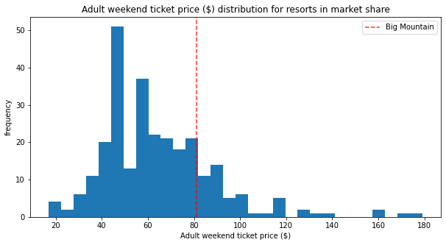
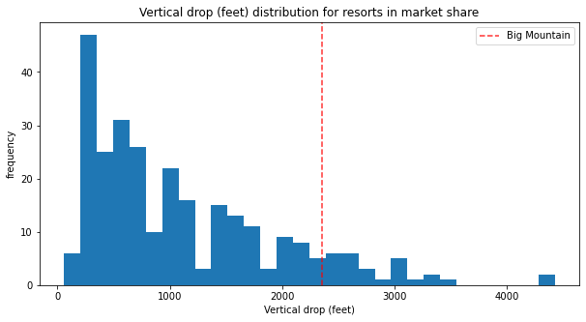
Modeling results and Analysis
Big Mountain’s price compared to other resorts
The Vertical drop feature positions Big Mountain in a premium market segment

Slide 5
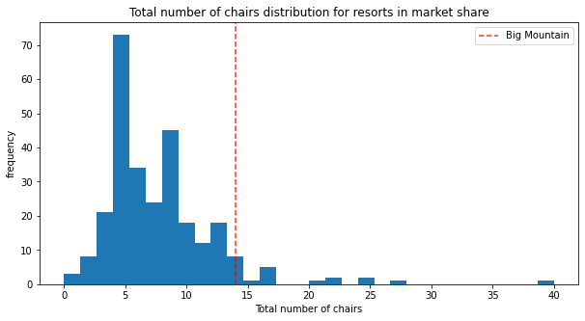
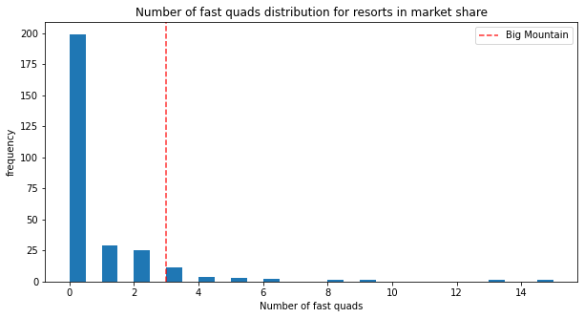
Modeling results and Analysis cont.
Big Mountain has amongst the highest number of total chairs
Big Mountain has 3 fast quads which positions the resort high in the league in its market segment.

Slide 6
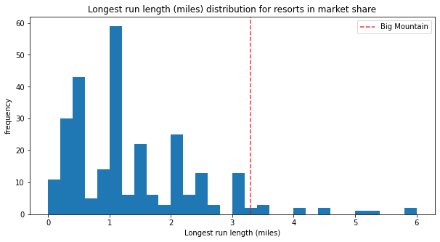
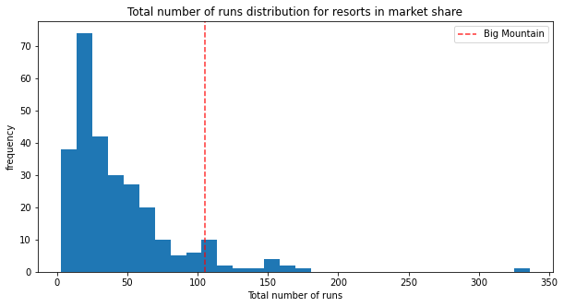
Modeling results and Analysis cont.
Big mountains offers good number of runs compared to most resorts
Big Mountain has one of the longest runs.

Slide 7
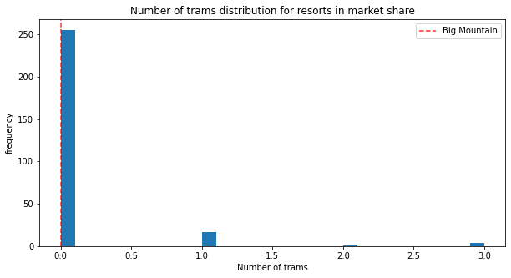
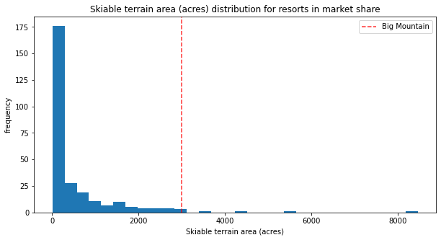
Modeling results and Analysis cont.
Big Mountain has no trams like most other resorts
Big Mountain is one of the resorts with largest amount of skiable terrain

Slide 8
Summary
Big Mountain resort has four key features that would validate the increase in ticket cost
Closing 3-5 runs will not affect the ticket price but will decrease the operational cost
In addition, the resort can add value by
increasing the vertical drop by 150 ft,
installing additional Chair Lift and
adding 2 acres of snow making

Slide 9
Conclusion
This pricing strategy will increase the resort’s revenue by $1.5M – $1.7 M and cut the operational cost while offering premium experience.
It is recommended that Big Mountain resort shall implement the pricing model suggested by this analysis to grow its revenue and cover any additional operational cost caused by the installation of chair lifts
The analysis demonstrates that Big Mountain can sustain the new pricing for many more years

